Slide 1

Hammer Wing
Team #08

Slide 2
Agenda
Introduction
Plan for Application Development
Data Model Structure
Areas of Focus
Summary
Validation Info
Primary Goals
Presentation Title

Slide 3

Introduction
Hammer Wing is a group of passionate programmers, we develop the thoughtful, high-quality Software applications for your business. We build custom software such as JavaScript, .Net, Python, Bootstrap, C# and CSS. Our team is always ready to go.

Slide 4
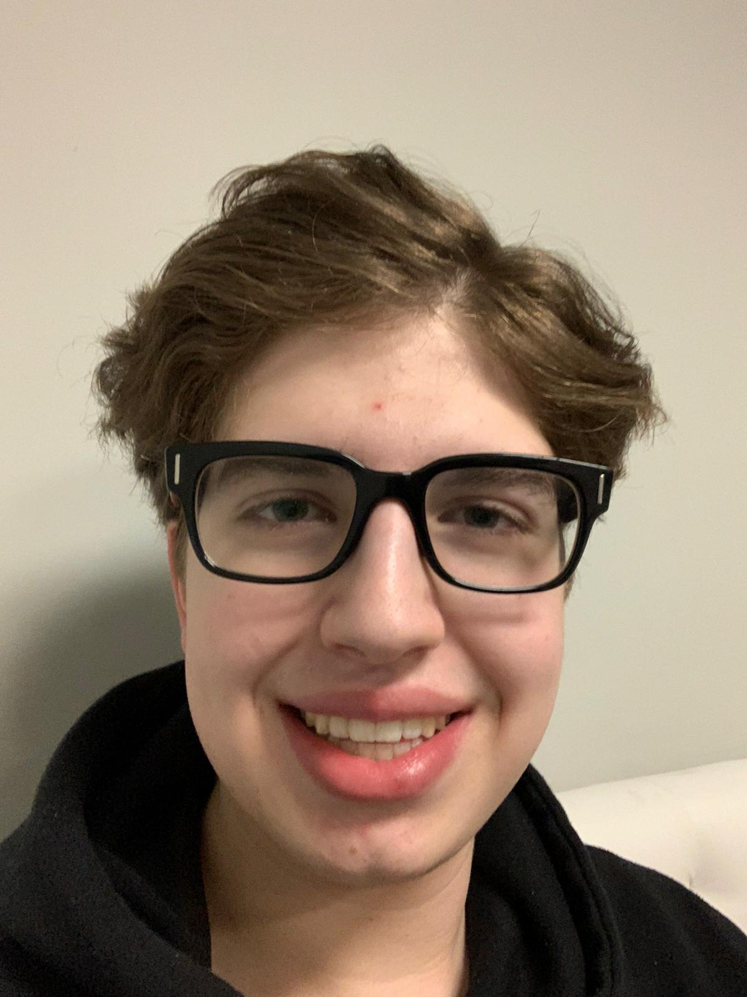
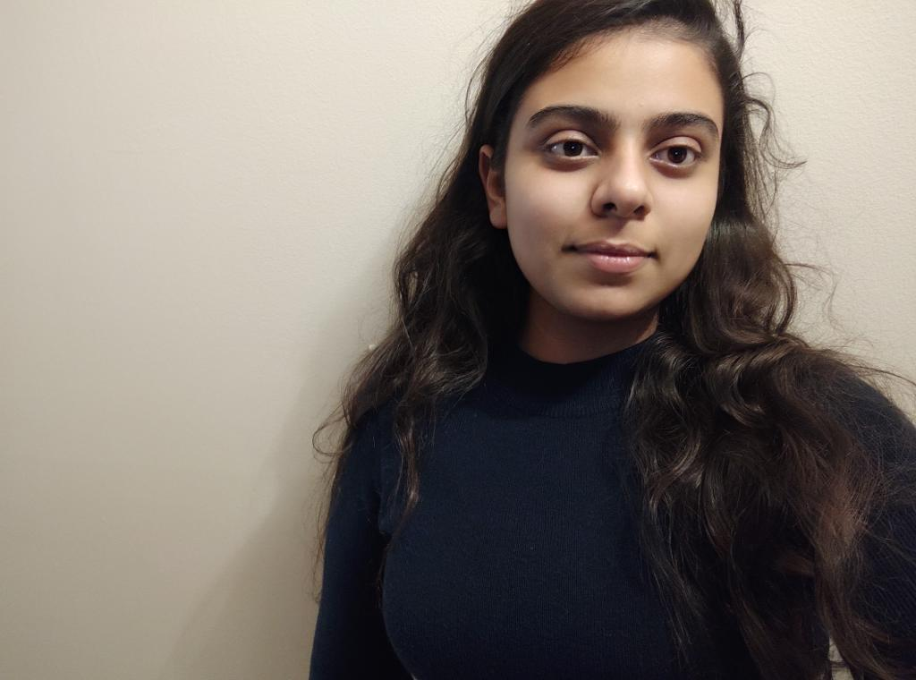
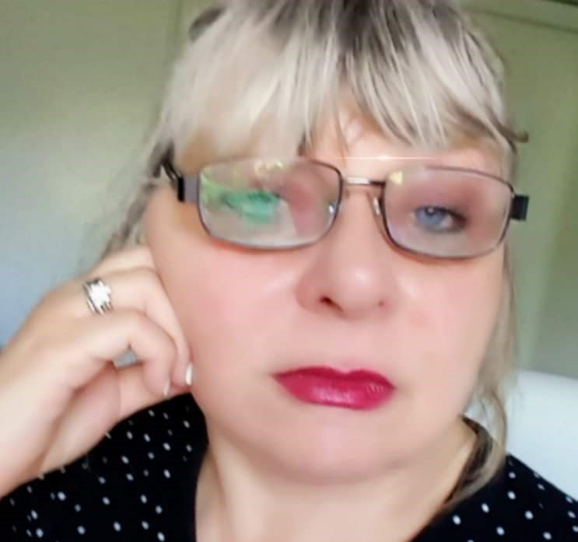
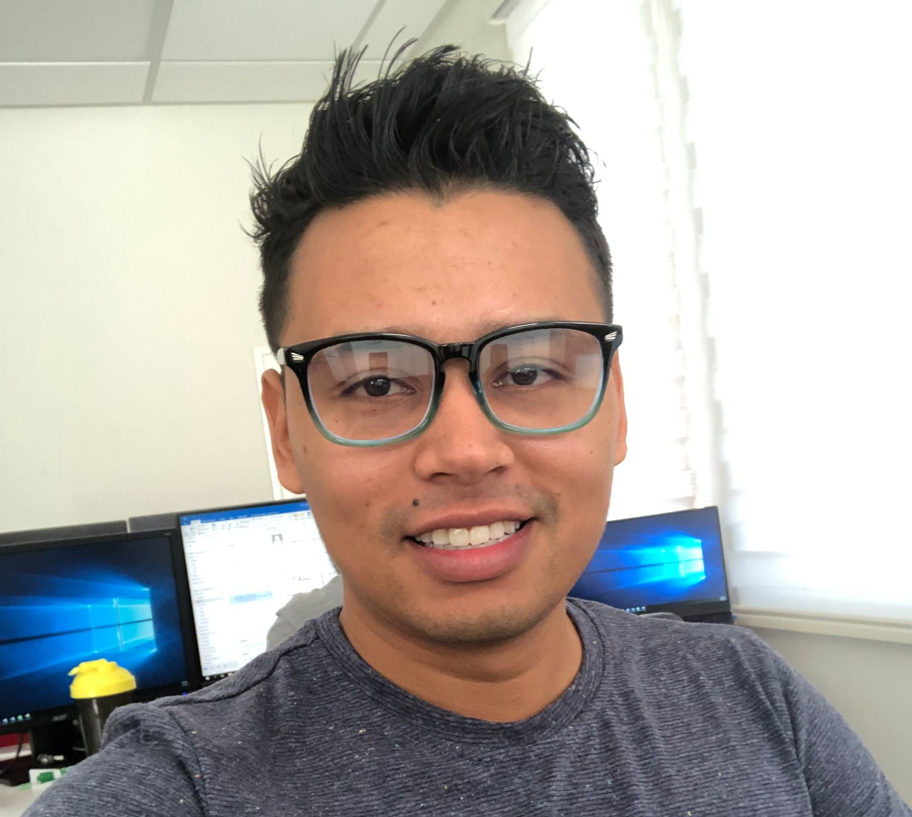

Meet our team
Matthew Brgan
Navpreet Kaur
Joanna Poczta
GitHub Manager
Presentation Coordination
Scheduler & Team Leader
Kevin Garcia Perdomo
Viacheslav Krasnikov
Disaster Recovery Manager
Azure Hoster & Communications Manager

Slide 5
Matthew Brgan
Preferred Languages: Python, C#, JavaScript
Skills: Organization & Time Management, Teamwork & Collaboration, Inventory Management
Interests: Computer Software & Hardware

Slide 6
Kevin Garcia Perdomo
5 years of experience in Network Management
Microsoft Certification: MCSA
IT Experience: Network Support, Network Implementation

Slide 7
Navpreet Kaur
I am good at working on presentations, hardware installation, database, python as well as web designing.
I have an introvert personality type, most of the time I remain silent and utilize my energy on my work. Although, I like to listen and understand others feeling as well.

Slide 8
Viacheslav Krasnikov
Preferred Languages: C#, HTML, CSS, JavaScript
Skills: Problem-Solving, Excellent Communication, Active Listening
Software: Microsoft Visual Studio, SQL Management Studio, Microsoft Excel

Slide 9
Joanna Poczta
I am experienced systems, Business Analyst with solid educational background. I have a Computer Science Degree from Brock University.
Since then, I have been working in the public and private sectors In USA and Canada for many years, primarily as a systems analyst, and database developer.

Slide 10
Team Responsibilities
Matthew Brgan
Kevin Garcia Perdomo
Navpreet Kaur
Viacheslav Krasnikov
Joanna Poczta
CRUD Operations
The Menu Structure &
General Site Layout
Review of the provided Prototype Files
| Bootstrap
& User Manual
Seed Data
& Azure Hosting
Data Model Creation
& Validation

Slide 11
“If debugging is the process of removing software bugs, then programming must be the process of putting them in.”
Edsger Dijkstra

Slide 12


Primary Goals
simple , clean and understandable code

Slide 13





Plan for application development
Planning
Discussion
Design & Develop
Strategy
Execution
Plan scalable Programs
Deploy strategic networks with compelling
e-business needs
Coordinate and build
e-business applications
Foster superior software design patterns
Opening or execution of a program or task

Slide 14


Areas of Focus
Software Coding
Involves writing and testing of instructions for Software.
Responsible for fixing bugs and issuing updates.
Cross-functionality with writing operating systems, along with the hardware programmers.
Website Designers
Languages are used to create scripts and functions of a website.
Build eCommerce sites for retailers.
Data Model Creation
Demonstrate the types of data used and stored within the system.
Relationships among data types, the ways the data can be grouped and organized.

Slide 15



How we get there
Software
Use Visual Studio 2022 as it a sophisticated software to create websites
Ensure a quality Data model Creation and validation
Engage worldwide methodologies with web-enabled technologies
Languages & Web Design
Use C#, Bootstrap, .Net and HTML as programming languages
Seed data and CRUD operations in the project
User friendly Menu Structure and well-Organized Website Layout
Relationships
Build one-to-one customer service connection with innovative ideas
Maximize timely deliverables for real-time schemas
Collaborate with all team members to work effectively and efficiently together

Slide 16
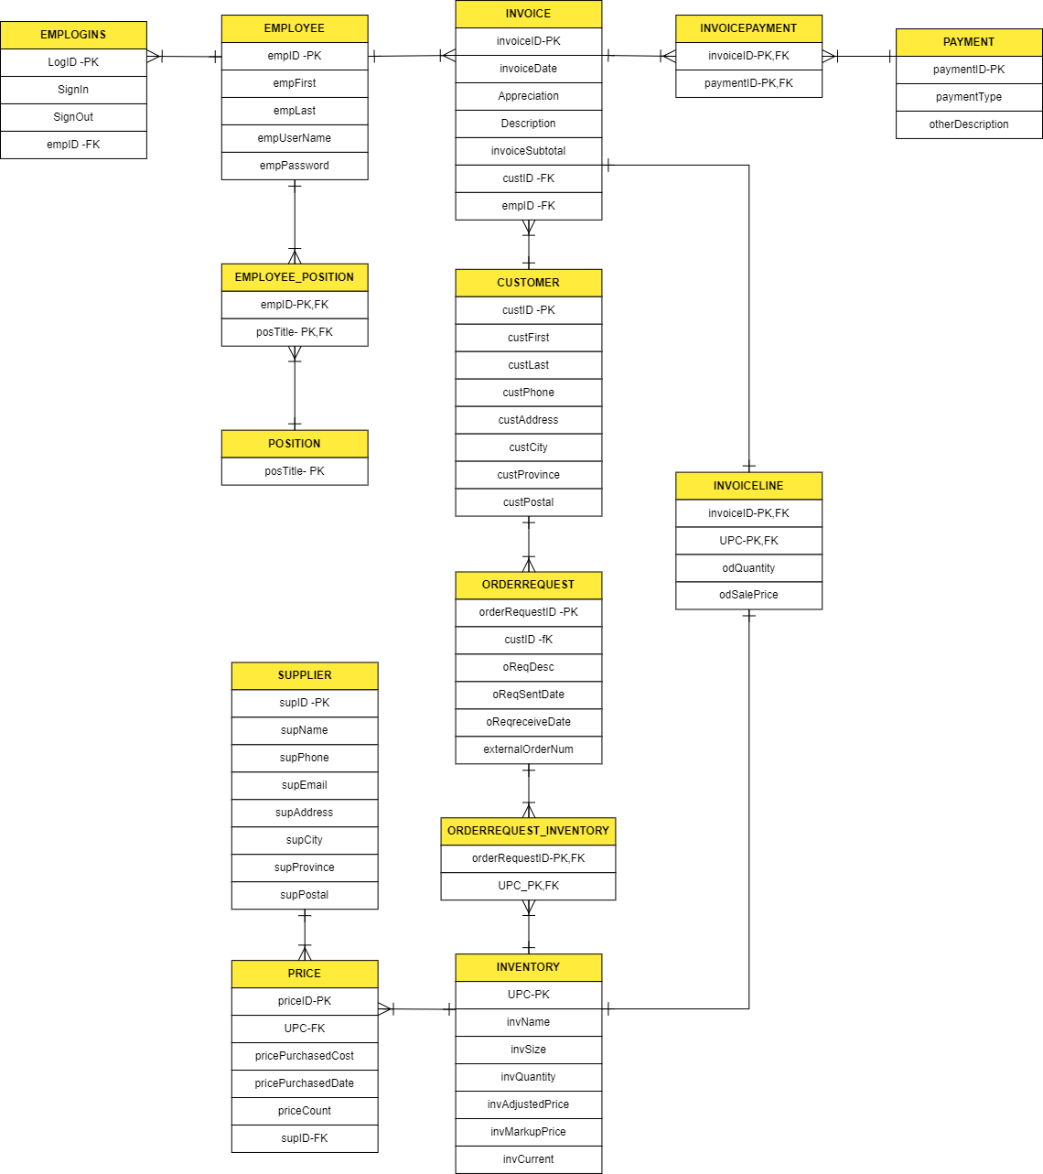
Data Model Structure

Slide 17
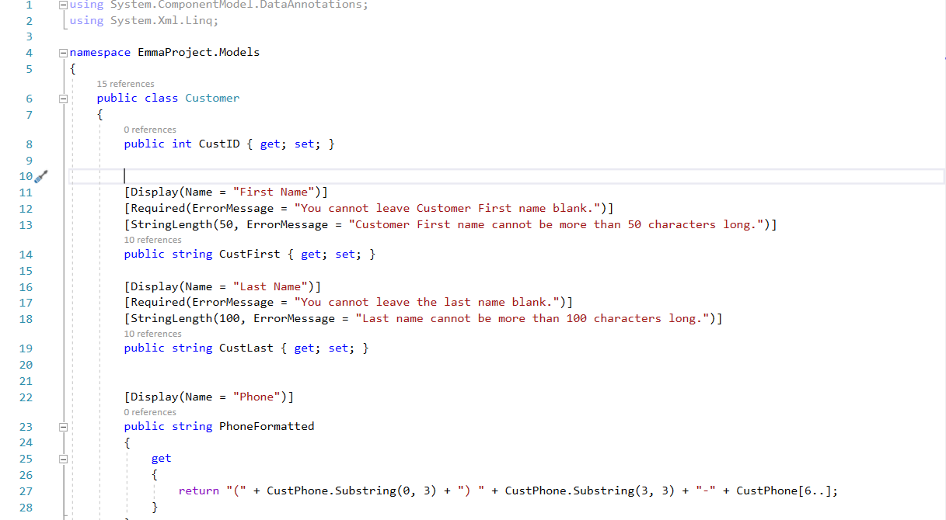
Customer page

Slide 18
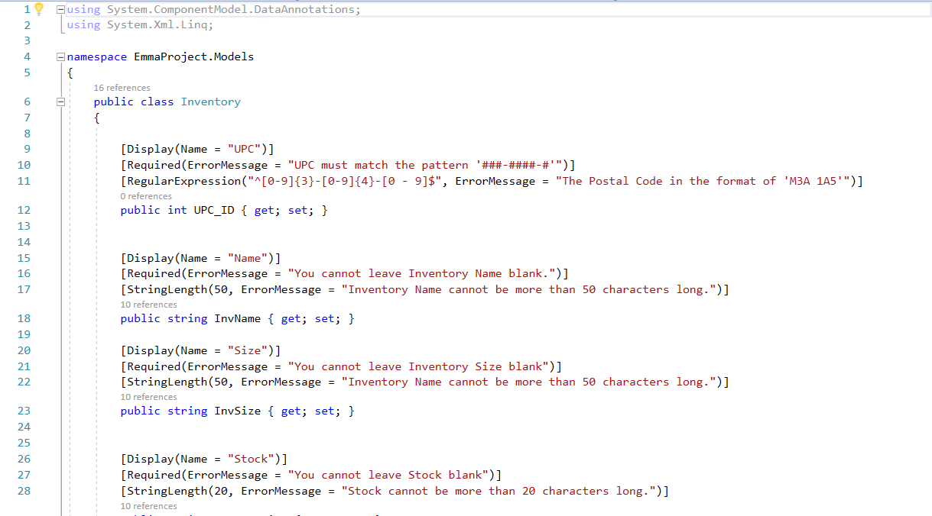
Inventory Page

Slide 19
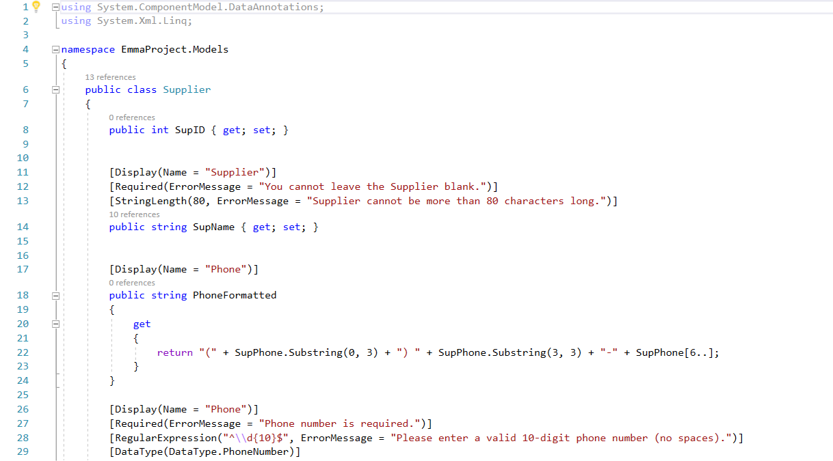
Supplier Page

Slide 20


Summary
At Hammer Wing, we believe in giving 110%. By using our next-generation Computer Hardware and our knowledge, we help Business virtually to manage the workflows. We thrive because of our in-depth knowledge and great team behind our product.

Slide 21




Thank you
Team #08

